Slide 1
ELECTRICAL MACHINES
Unit 2
By Ms. Alagu Dheeraj
AP/ EEE/SSNCE

Slide 2
Contents
Overview of Direct Current Machines
Construction
Principle of Operation
Types of DC Motor
Power Flow Diagram
Speed Control

Slide 3
OBJECTIVES
Upon completion of the chapter the student should be able to:
State the principle by which machines convert mechanical energy to electrical energy.
Discuss the operating differences between different types of generators
Understand the principle of DC generator as it represents a logical behavior of dc motors.

Slide 4
Objectives
Find the force produced on a current-carrying wire in a magnetic field.
State the differences between a shunt and compound dc generator and describe the performance characteristics of each.
Sketch a simple dc motor and describe how it operates.
State the differences among a shunt, series, and compound dc motor, and describe the performance characteristics and application examples of each.

Slide 5
Introduction
Electromagnetic Energy Conversion:
When armature conductors move in a magnetic field produced by the current in stator field winding, voltage is induced in the armature conductors.
When current carrying armature conductors are placed in a magnetic field produced by the current in stator field winding, the armature conductors experience a mechanical force.
These two effects occur simultaneously in a DC machine whenever energy conversion takes place from electrical to mechanical or vice versa.

Slide 6
Direct Current (DC) Machines Fundamentals
Generator action: An emf (voltage) is induced in a conductor if it moves through a magnetic field.
Motor action: A force is induced in a conductor that has a current going through it and placed in a magnetic field.
Any DC machine can act either as a generator or as a motor.

Slide 7
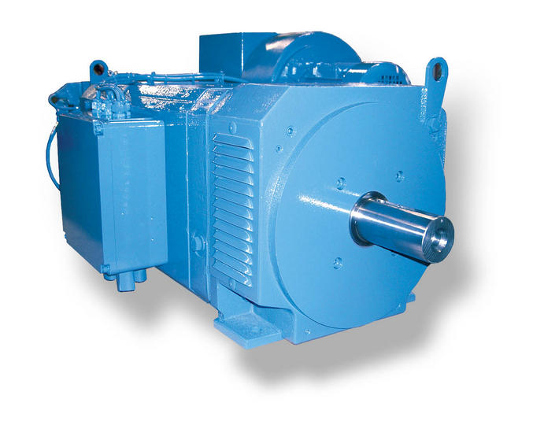
Overview of Direct Current Machines
Direct-current (DC) machines are divided into dc generators and dc motors.
DC generators are not as common as they used to be, because direct current, when required, is mainly produced by electronic rectifiers.
While dc motors are widely used
in many applications.

Slide 8
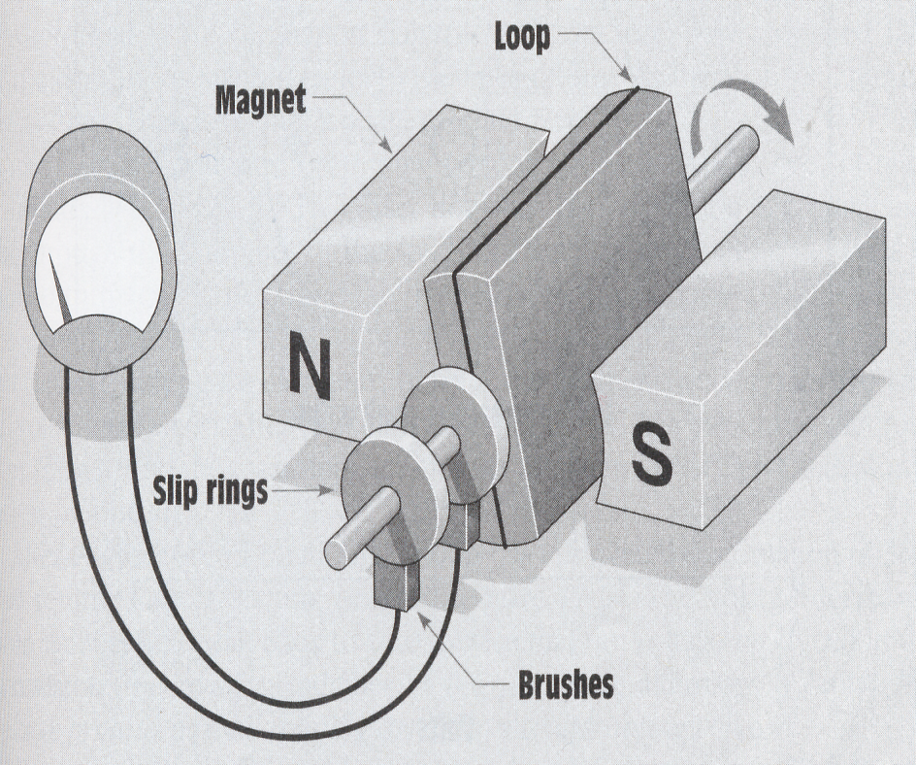
DC Generator
A dc generator is a machine that converts mechanical energy into electrical energy (dc voltage and current) by using the principle of magnetic induction.
In this example, the ends of the wire loop have been connected to two slip rings mounted on the shaft, while brushes are used to carry the current from the loop to the outside of the circuit.
Principle of magnetic induction in DC machine

Slide 9
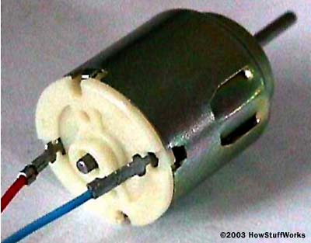
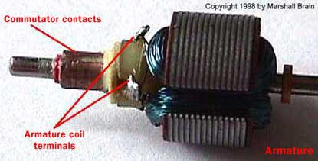
DC Motor
DC motors are everywhere! In a house, almost every mechanical movement that you see around you is caused by an DC (direct current) motor.
An dc motor is a machine that converts electrical energy into mechanical energy by supplying a dc power (voltage and current).

Slide 10
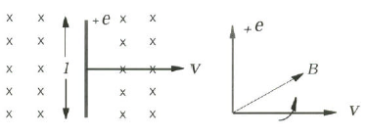
Motional Voltage, e
e=Blv, where B, v and e are mutually perpendicular. The polarity of the induced voltage can be determined from the right hand screw rule. Turn the vector v towards the vector B. If a right hand screw is turned in the same way the motion of the screw will indicate the direction of positive polarity of the induced voltage e.

Slide 11
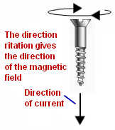
Maxwell’s Cork screw Rule

Slide 12
Maxwell’s Cork screw Rule
Hold the cork screw in yr right hand and rotate it in clockwise in such a way that it advances in the direction of current. Then the direction in which the hand rotates will be the direction of magnetic lines of force .

Slide 13
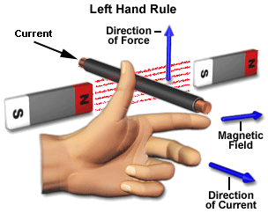
Fleming’s left hand rule

Slide 14
Fleming’s left hand rule
Used to determine the direction of force acting on a current carrying conductor placed in a magnetic field .
The middle finger , the fore finger and thumb of the left hand are kept at right angles to one another .
The middle finger represent the direction of current
The fore finger represent the direction of magnetic field
The thumb will indicate the direction of force acting on the conductor .
This rule is used in Motors.

Slide 15
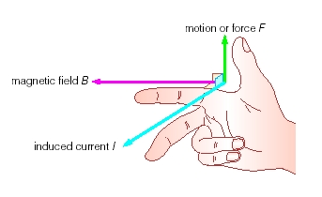
Fleming’s Right hand rule

Slide 16
Fleming’s Right hand rule
Used to determine the direction of emf induced in a conductor
The middle finger , the fore finger and thumb of the left hand are kept at right angles to one another.
The fore finger represent the direction of magnetic field
The thumb represent the direction of motion of the conductor
The middle finger will indicate the direction of the inducted emf . This rule is used in Generators.
This rule is used in DC Generators

Slide 17
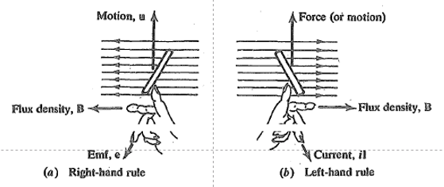

Slide 18
Len’s Law
The direction of induced emf is given by Lenz’s law .
According to this law, the induced emf will be acting in such a way so as to oppose the very cause of production of it .
e = -N (dØ/dt) volts

Slide 19
Magnetic Induction and the DC Generator
Faraday’s Law e = N dΦ / dt
e = the induced voltage in volts (V)
N = the number of series-connected turns of wire in turns (t)
dΦ/dt = rate of change in flux in Webers/second (Wb/s)
e = B L v
B = the flux density in teslas (T)
L = the length of the conductor that is in the magnetic field in meters (m)
v = the relative velocity between the wire and the flux, in meters/second (m/s)

Slide 20
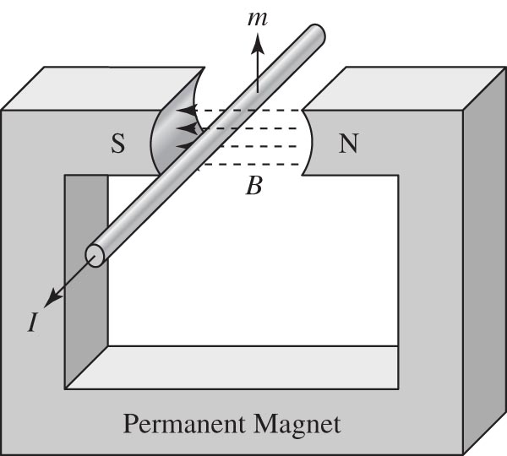
Magnetic induction in a wire moving in a field.

Slide 21
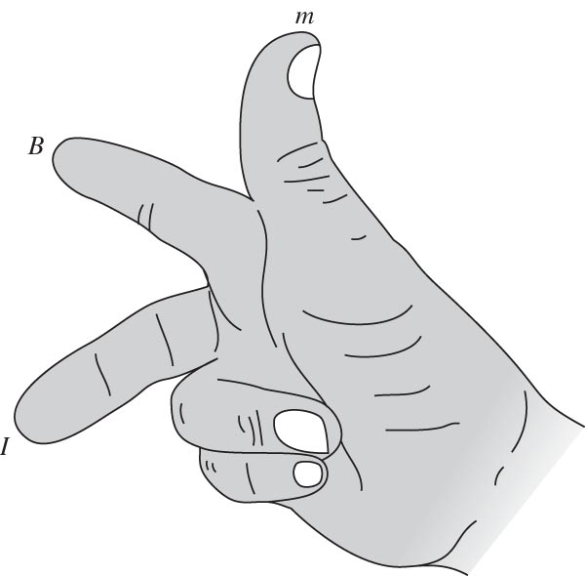
Right-hand rule for magnetic induction.

Slide 22
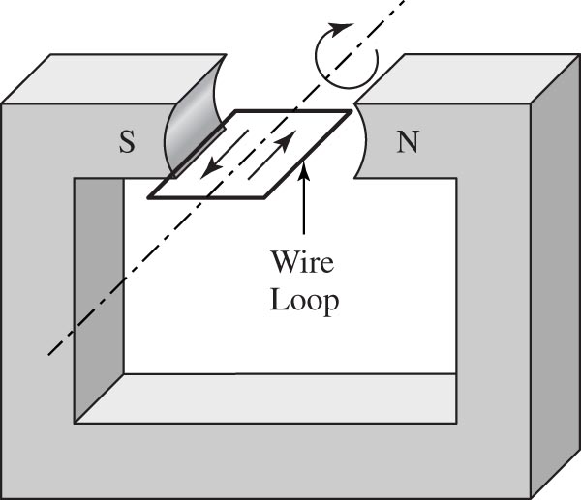
Wire loop rotating in a magnetic field.

Slide 23
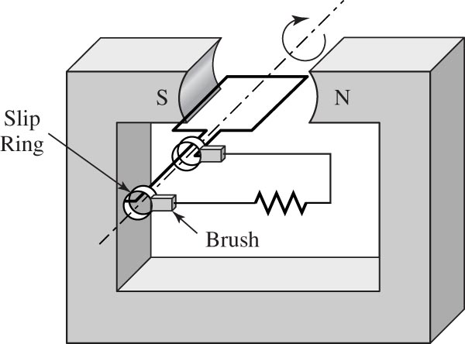
AC generator with slip rings and brushes.

Slide 24
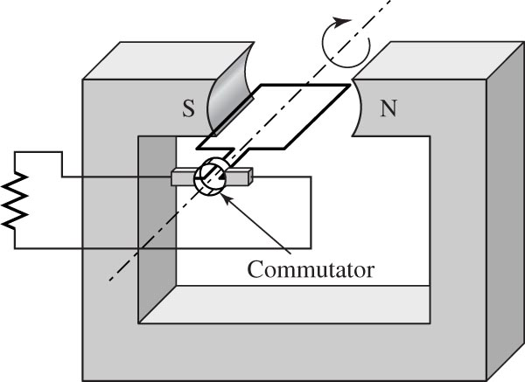
DC generator with commutator and brushes.

Slide 25
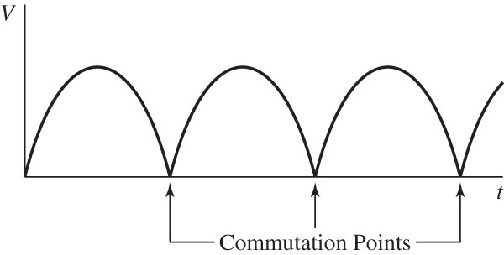
DC generator output waveform.

Slide 26
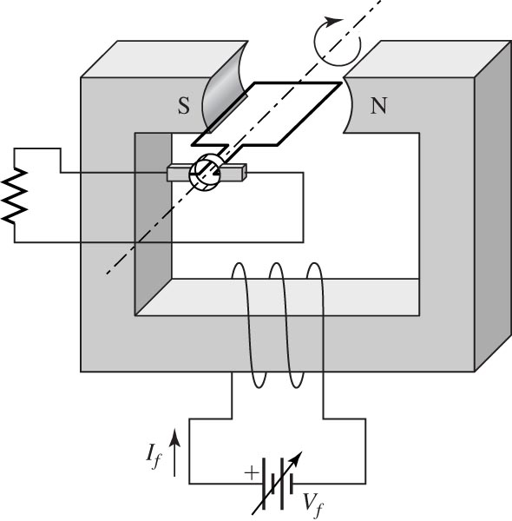
DC generator with field control.

Slide 27
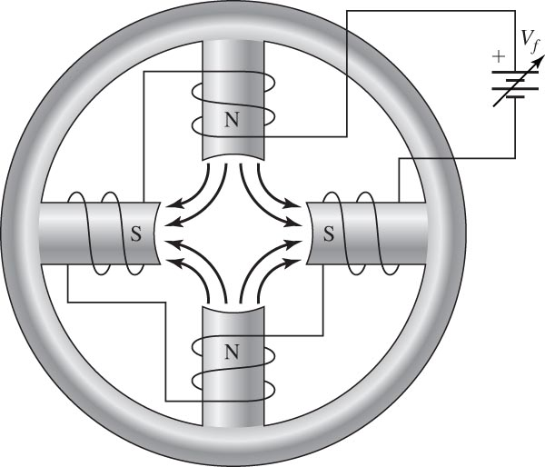
DC generator four-pole field.

Slide 28
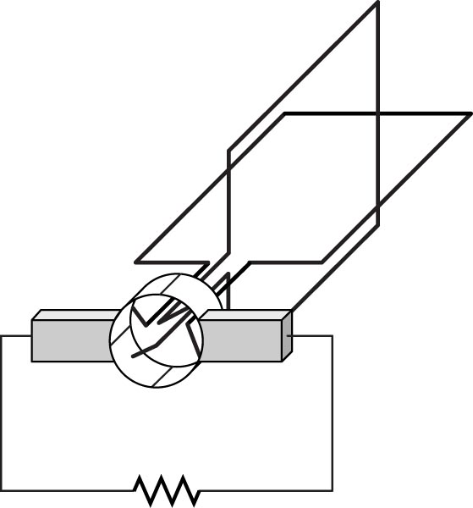
DC generator rotor with two coils.

Slide 29
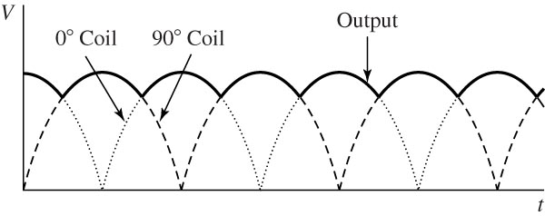
Coil and output waveforms for a two-winding rotor

Slide 30
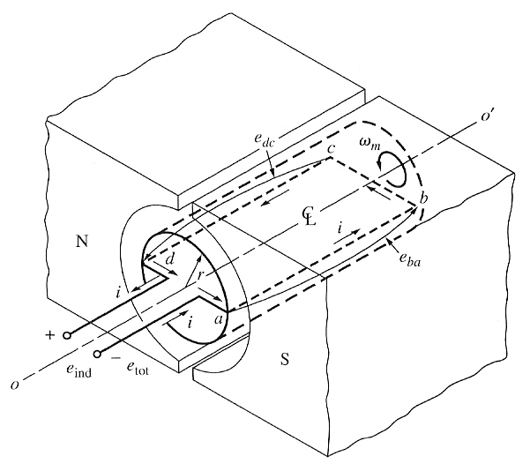
Simplest rotating dc machine
It consists of a single loop of wire rotating about a fixed axis.
The rotating part is called rotor, and the stationary part is the stator.
The magnetic field for the machine is supplied by the magnetic north and south poles. With uniform air gap, the reluctance is same under the pole faces.

Slide 31
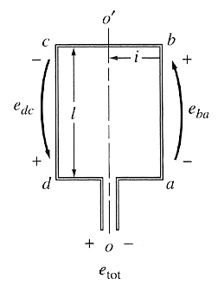
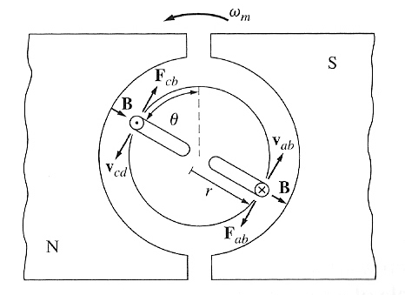
The Voltage Induced in a Rotating Loop
If the rotor is rotated, a voltage will be induced in the wire loop.
The voltage on each segment is given by eind = (v x B) . l
The total induced voltage on the loop is: eind = 2vBl

Slide 32
The Voltage Induced in a Rotating Loop
When the loop rotates through 180°,
segment ab is under the opposite pole face
the direction of the voltage on the segment reverses
its magnitude remains constant
The resulting voltage e_{tot}

Slide 33
Getting DC voltage out of the Rotating Loop
Using a mechanism called commutator and brushes dc voltage can be obtained from ac voltage
at the instant when the voltage in the loop is zero, the contacts short-circuit the two segments
every time the voltage of the loop switches direction, the contacts also switches connections
This connection-switching process is known as commutation

Slide 34
Induced Torque in the Rotating Loop
In general, the torque in any real machine will depend on the same 3 factors:
1. The flux in the machine
2. The current in the machine
3. A constant representing the construction of the machine.

